Slide 1
International Collaboration in Anaesthesia
Recipe for success
Past and Future
Lars Irestedt Assoc. Professor Karolinska Institutet
Vice Chairman, Life Support Foundation

Slide 3
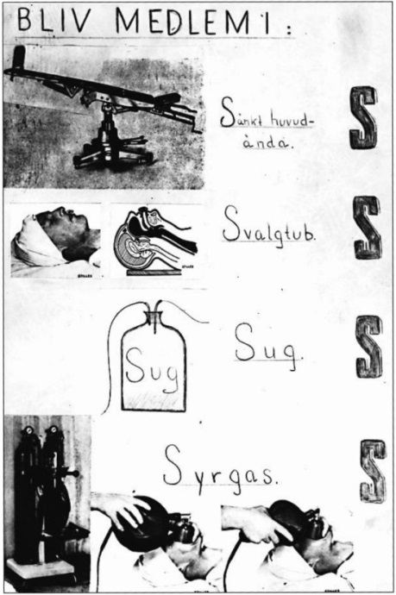
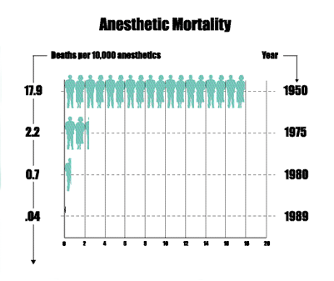
Recipe for success, Past
1940. Torsten Gordh, Sweden’s first Anaesthesiologist
Reduced death in abdominal surgery by 40%
Europe

Slide 4
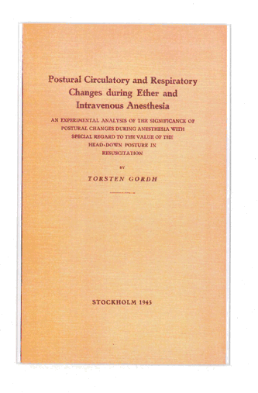
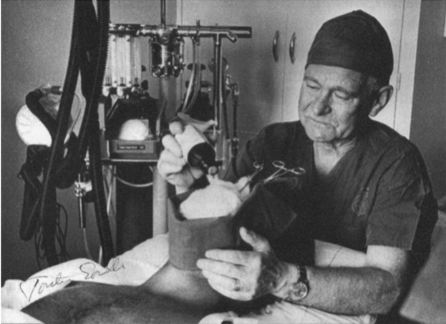

Slide 5
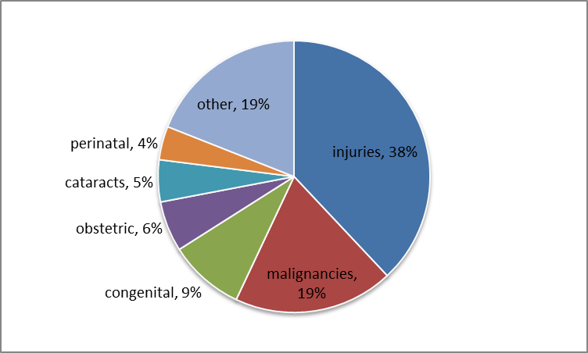
Global Surgery
10% of deaths (4,7 million)
due to surgically treatable conditions (Lozano 2013)
Provision of essential surgical procedures would save 1.5 million deaths a year

Slide 6
Global Surgery
234 million operations per year globally
5 billion people lack access to basic surgery (Lancet 2015)
Only 3·5% of operations are in low-income countries where 35% of the world’s people live

Slide 7
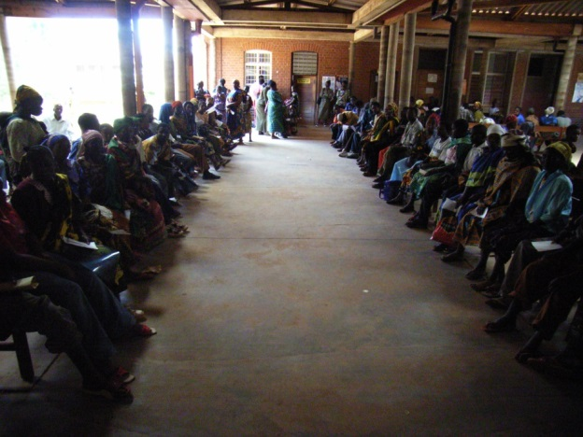
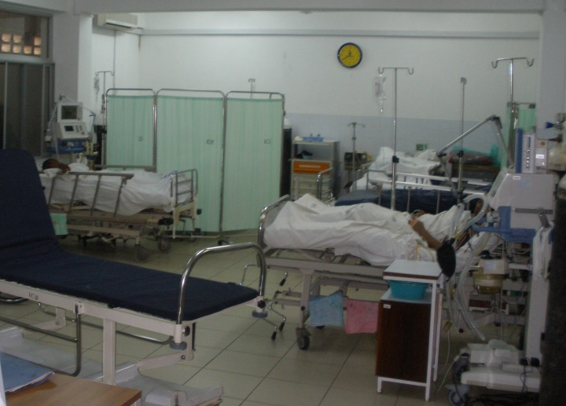
Global Critical Care
Critical Care is often absent or poor quality
60% had ER, 40% had triage, 30% had ICU
80% no staff trained in triage or critical care
Mortality on ICU 50% (90% if hypotensive)
Acute treatments rarely given (3%)

Slide 8
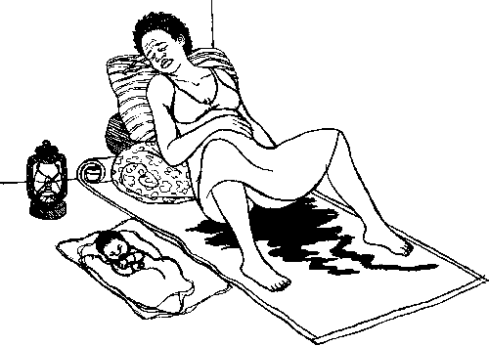
Global Obstetrics
More than half of women lack access to Emergency Obstetric Care (80% in LIC) (Holmer 2015)
Good quality care could prevent
113 000 maternal deaths

Slide 9
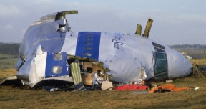
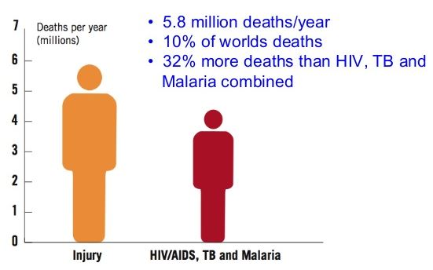
The Global Need
2 jumbo jets full of mothers crash every day
Every girl in Tanzania has a 1 in 20 risk of dying during childbirth
1 million babies die each year on the same day they are born (and over 2 million are stillbirths)
5.8 million deaths from trauma yearly¹
Muhimbili National Hospital:
9.6%
1.54%²
Perinatal death:
Maternal Mortality:
1 World report on road traffic injury prevention, WHO, 2004
2
Pembe, A. B., et al. (2014). "Maternal mortality at Muhimbili National Hospital in Dar-es-Salaam, Tanzania in the year 2011." BMC Pregnancy Childbirth 14: 320.

Slide 10
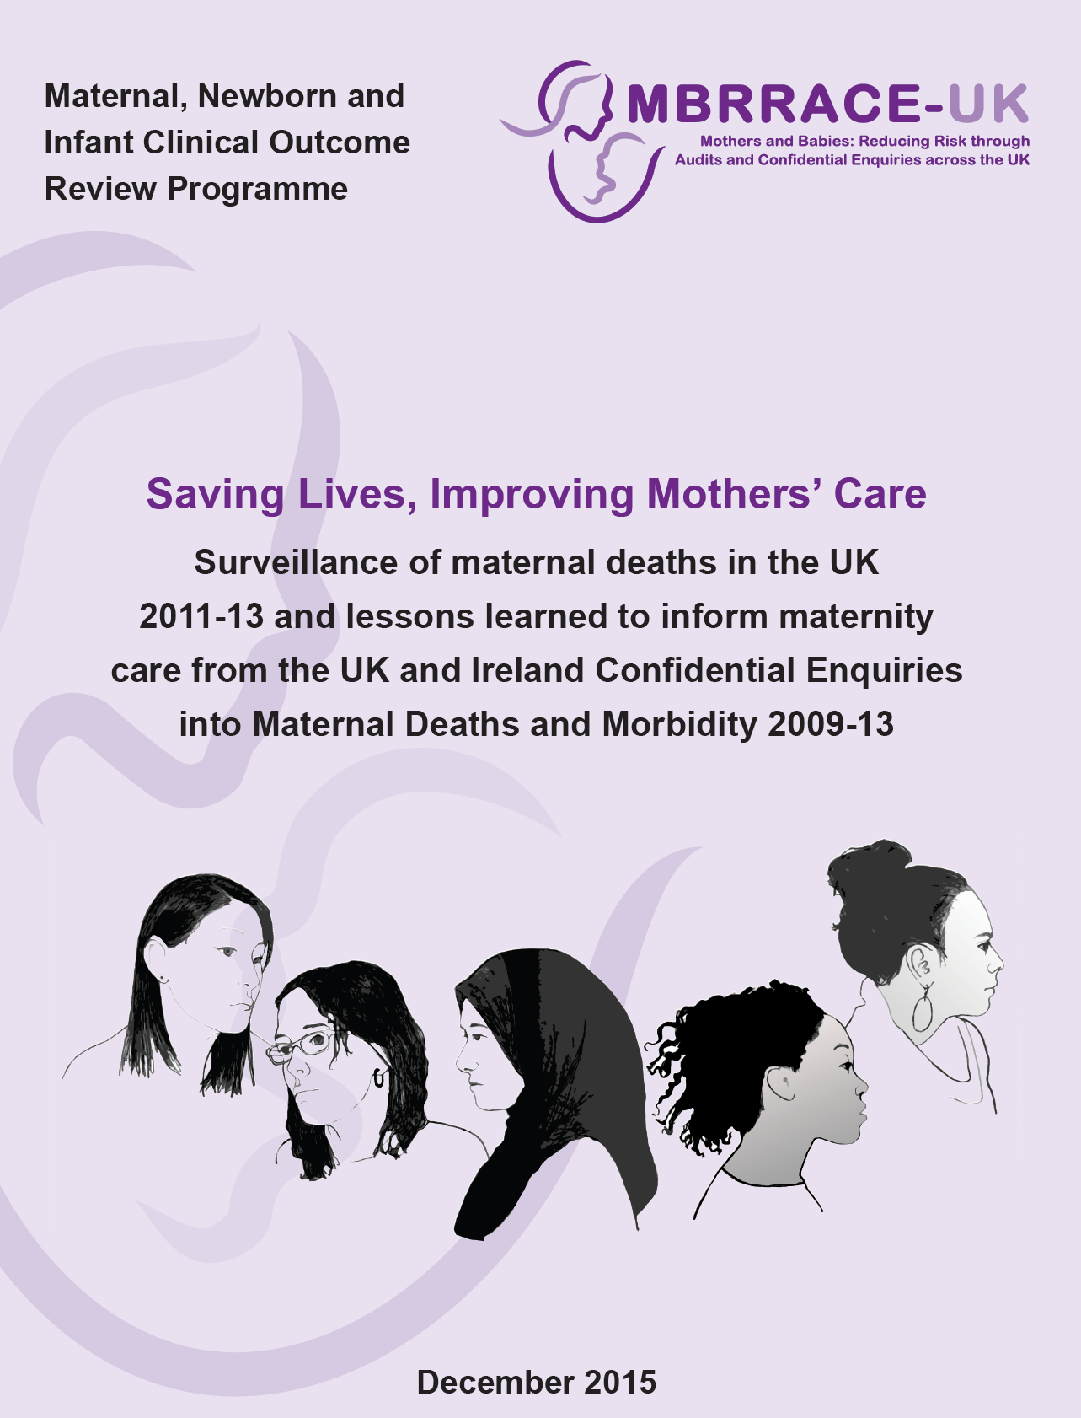

Slide 11
Anaesthesia related direct maternal deaths.
UK experience
Triage
Emergency care: ABC
Regional Anaesthesia
Senior Interest
Routines and guidelines
Improved Training
Teamwork
Communication
Checklists
Audit, M & M, systematic improvements

Slide 12
UK: preventable reasons for maternal deaths
Recurrent themes:
Failure to recognise problems
Failure to take action
Failure to refer
Inappropriate delegation to junior staff
Poor or non-existent teamworking
Notes:
12

Slide 13
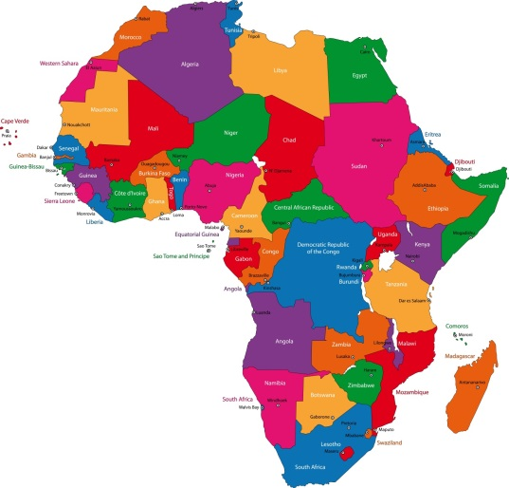
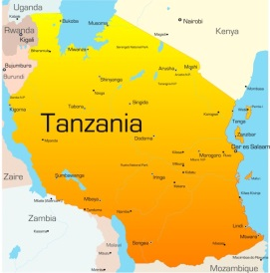
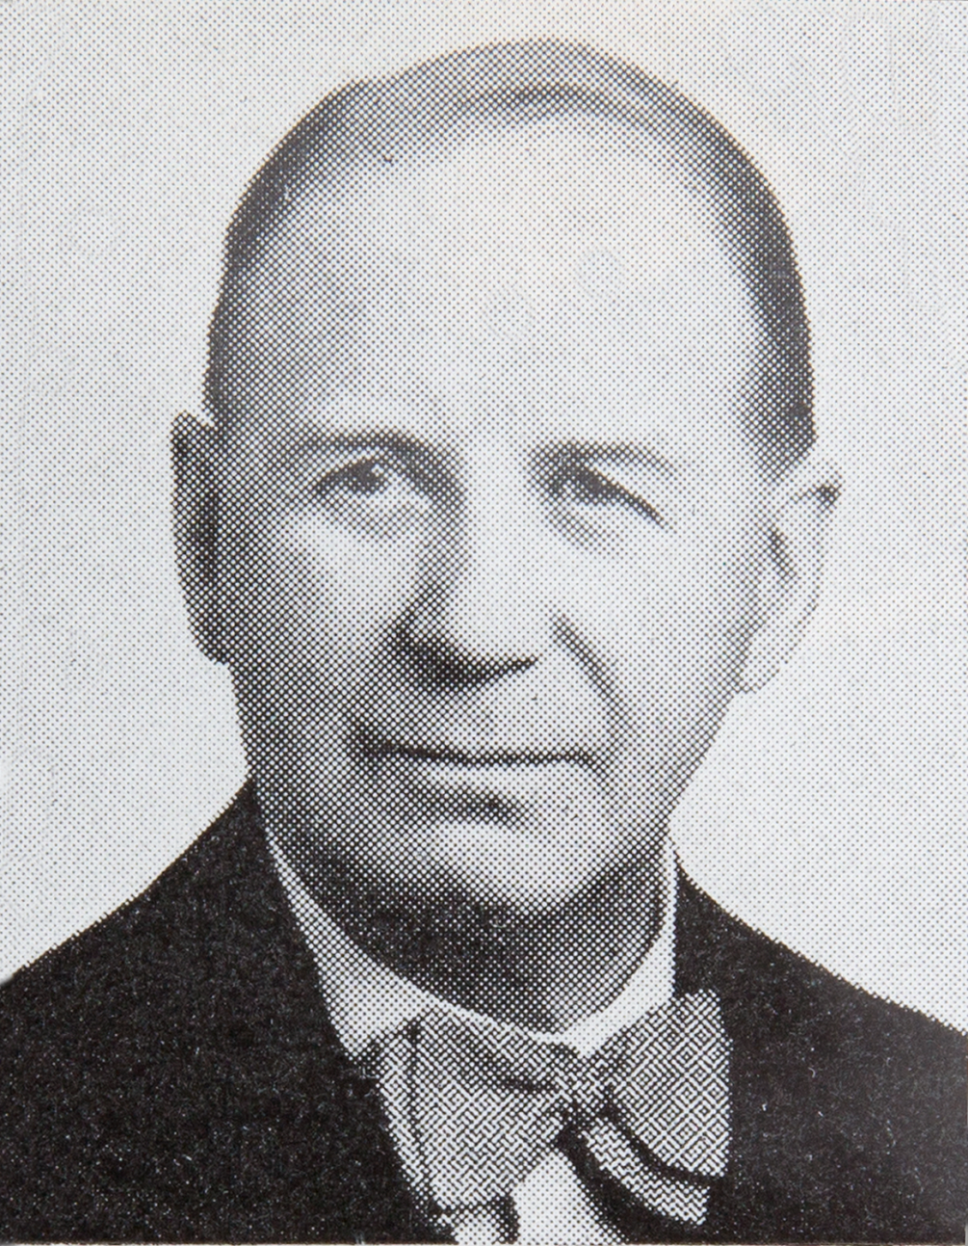
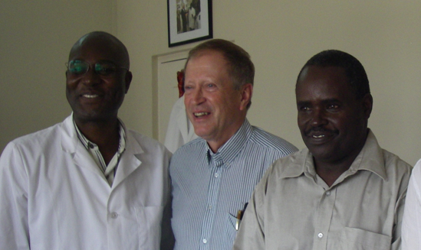
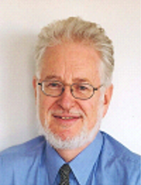
Background
2005-2006 Dr Tim Baker worked as a volunteer doctor in Tanzania.
2008 a request for help from Muhimbili National Hospital to Karolinska University Hospital

Slide 14
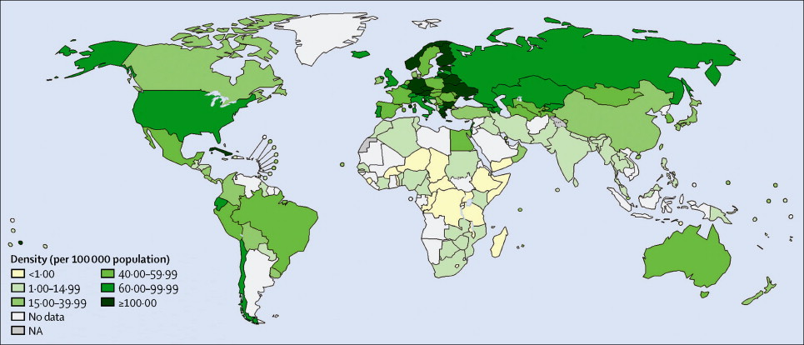
Global distribution of surgeons, anesthesiologists and obstetricians; per 100 000 population
Karolinska University Hospital: 187 (2400 in Sweden)
Muhimbili National Hospital: 5 (20 in Tanzania)

Slide 15
And the world is starting to wake up to these ideas
“To get a drop in maternal mortality requires a medical health-care system that is responsive to the 24-hour technical needs of a woman in labour” (Lancet 2012)
“Strengthening the delivery of essential surgical services must be a priority if we are to reduce mortality and morbidity” (WHO Safe Surgery 2011)

Slide 16
Encouraging involvement in global health
”We encourage UK health workers
and employers to take advantage of
opportunities to engage in
global health.
Your involvement is important.”

Slide 17
Encouraging involvement in global health at Karolinska Hospital?
1. Recruitment and retention of all staff
– added value of employment
– case load and rare cases
2. Clinical skills
3. Managerial skills
– innovation & ability to cope with limited resources
– multi-cultural and multi-disciplinary
4. Communication & teamwork
– understanding of cultures and settings
5. Patient Experience and dignity
6. Service/policy development & implementation
– new perspectives
7. Academic skills
– opportunities to engage in education and research

Slide 18
Life Support Foundation Established 2013
“an international, independent, medical organisation aiming to prevent deaths due to acute, life-threatening conditions in low-income countries through improving the access to and quality of basic life-saving interventions”

Slide 19
Staff exchange
Equipment provision
Training courses
Supportive actions of Link
MKAIC & LSF
Training of trainers, ABC
Checklists
Support anaesthesia residency
Development of protocols
SATA support
Research
Regional activities

Slide 21
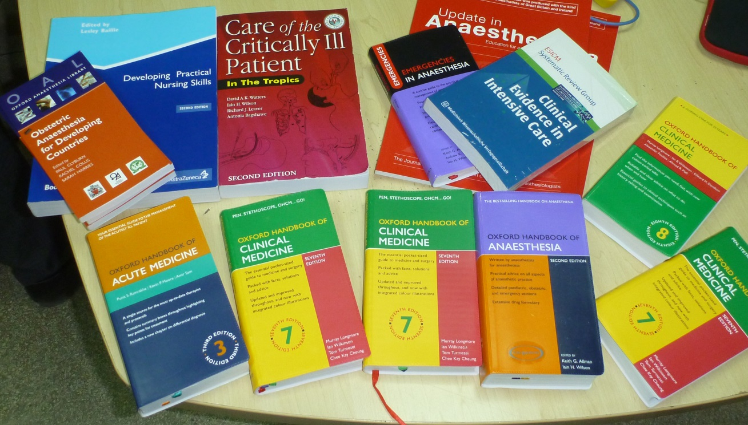

Slide 22
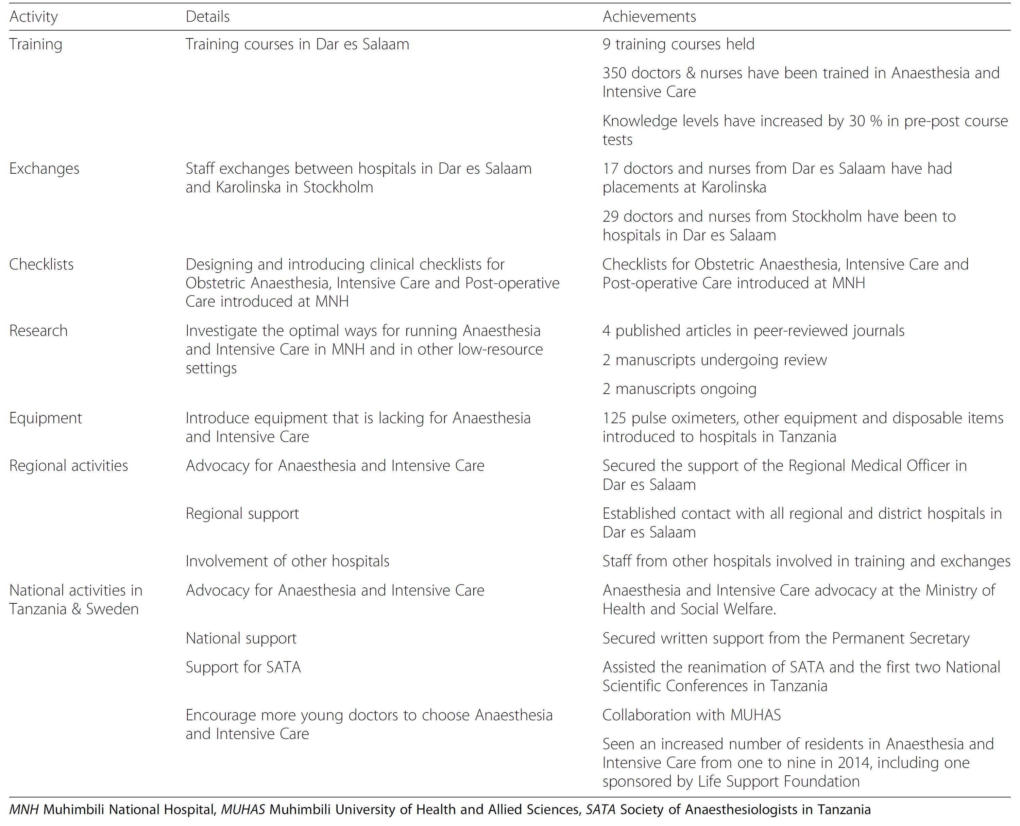
Achievements 2008-2015

Slide 23
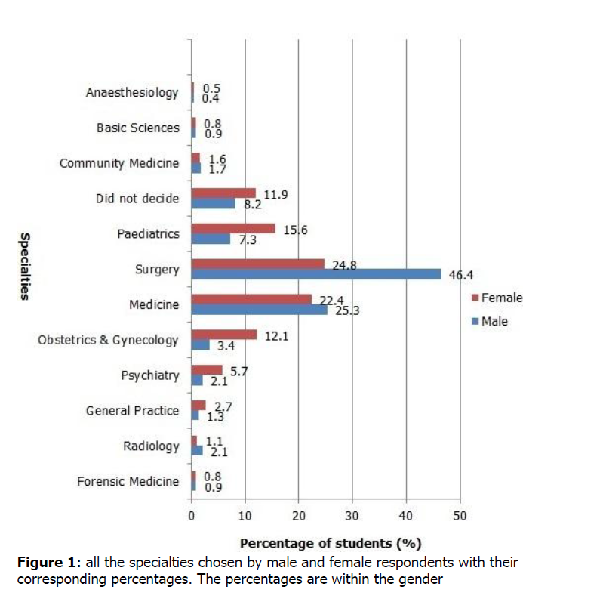
”The least selected speciality was Anaesthesiology”

Slide 24
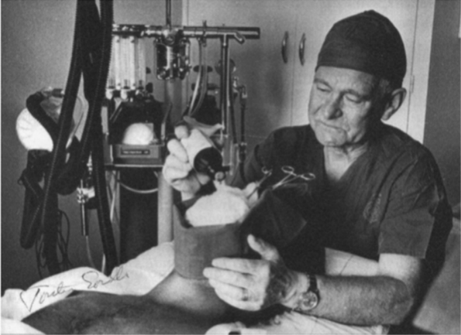
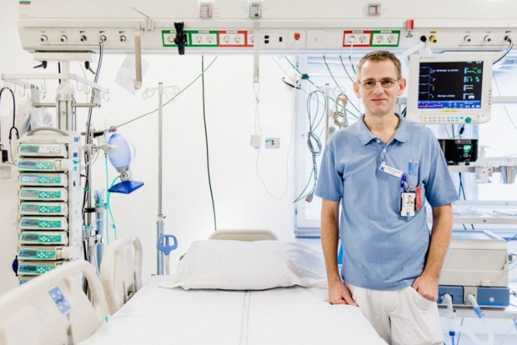
Recipe for success, Future
The Development of Anaesthesia and Intensive care has fundamentally reduced morbidity and mortality worldwide. Anaesthesia is the largest in-hospital speciality in Sweden Anaesthesia is as respected as any other speciality in Sweden Anaesthesia offers great career possibilities in Sweden
75 years
Tanzania is ready for the same journey as Sweden and International Collaborations like Life Support Foundation will aid the journey.

